Slide 1
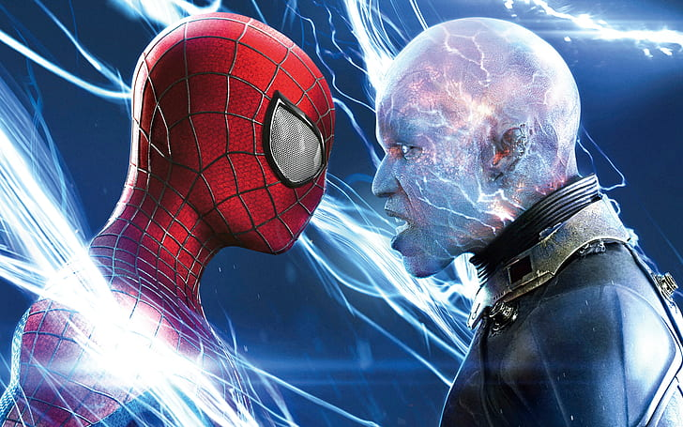

Top MOVIES Of All Time
Abdush-Shakoor Milton
This Photo by Unknown Author is licensed under CC BY-NC

Slide 2

RANK | TITLE OF MOVIE | LIFETIME GROSS[$] | YEAR
1. | Avatar | $2,923,706,026 | 2009
2. | Avengers: Endgame | $2,799,439,100 | 2019
3. | Avatar: The Way Of Water | $2,320,250,281 | 2022
4. | Titanic | $2,264,750,694 | 1997
5. | Star Wars: Episode VII-THE FORCE AWAKENS | $2,071,310,218 | 2015
6. | Avengers: Infinity War | $2,052,415,039 | 2018
7. | Spider-Man: No Way Home | $1,921,847,111 | 2021
8. | Jurassic World | $1,671,537,444 | 2015
9. | The Lion King | $1,663,079,059 | 2019
10. | Avengers: Age Of Ultron | $1,542,317,294 | 2015
11. | Furious 7 | $1,527,251,659 | 2015
12. | The Avengers | $1,520,538,536 | 2012
13. | Top Gun: Maverick | $1,495, 696,292 | 2022
14. | Frozen 2 | $1,397,045,694 | 2019
15. | Barbie | $1,445,638,421 | 2023
16. | Frozen | $1,397,045,694 | 2013
17. | The Super Mario Bros: Movie | $1,361,955,498 | 2023

Slide 3
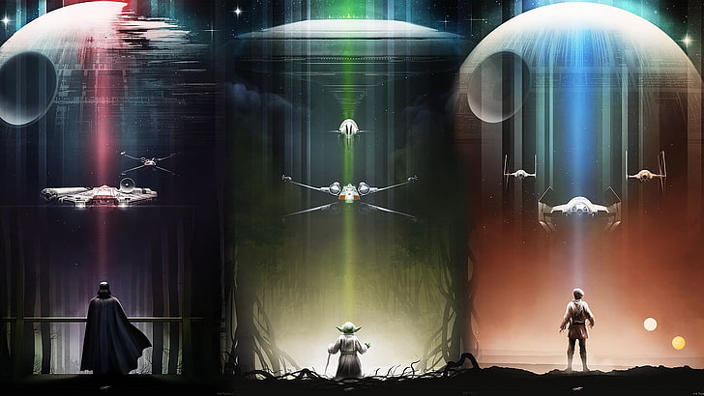
RANK | TITLE OF MOVIE | LIFETIME GROSS[$] | YEAR
18. | Harry Potter and The Deathly Hallows; Part 2 | $1,356,841,356 | 2011
19. | Black Panther | $1,349,926 ,083 | 2018
20. | Star Wars: Episode VIII – The last Jedi | $1,334,407,706 | 2017
21. | Jurassic Park : Fallen Kingdom | $1,310,466,296 | 2018
22. | Beauty And The Beast | $1,266,115,964 | 2017
23 | Incredibles 2 | $1,243,225,,667 | 2018
24. | The Fate And The Furious | $1,2236,005,118 | 2017
25 | Iron Man 3 | $1,215,577,205 | 2013

